Slide 1
Chapter 7. Analytic Geometry in 3D
C. C. Huang
Computer Science ECNU
2016.10.10

Slide 2
§7.2
2. Unit vector is ,
or .
3. .

Slide 3
§7.3
1. (3) .
(4) .
2.
5.

Slide 4
§7.3
8. (3) .
(4) .
10.(2) Three vectors lie in a plane, since .
12.

Slide 5
§7.4
1. (2) .
(4) ,
.
(6) .
(8) ,
.

Slide 6
§7.4
4. .
6.
8. Assume that the function of the plane is .
We have
=> .

Slide 7
§7.5
1.(1) .
(3) , .
2.(2) find another vector lies on the plane to compute the normal vector.
(4) .

Slide 8
§7.5
Let P be the projective point of A
90º
8. C

Slide 9
§7.7
2. , or
.
We do not care the coordinate z, so eliminate the variable z in equations
8. Eliminate the variable z
(1) . (2) .

Slide 10
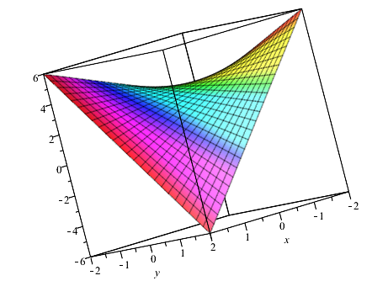
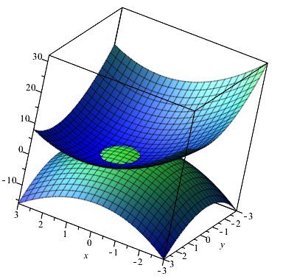
Review Exercises of §7
2. .
.
7. .
.
10. Eliminate z, x, and y respectively.

Slide 11
From the Perspective of Linear Algebra
In 3D space :
a line has 1-df. <=> 2 different linear relations (equations)
<=> solution space
a plane has 2-df. <=> 1 different linear relation (equation)
<=> solution space
lines and planes are all linear space.
1 point
1 direction vector
1 point
2 direction vectors
which are linear independent

Slide 12
From the Perspective of Linear Algebra
In 3D space :
a line has 1-df. <=> 2 different linear relations (equations)
<=> solution space
<=> its normal equation
a plane has 2-df. <=> 1 different linear relation (equation)
<=> solution space
<=> its normal equation
lines and planes are all linear space.
Seems quite different!

Slide 13
From the Perspective of Linear Algebra
A Plane:
solution space
We solve last 2 equations:
By Cramer's Rule,
Substitute into the 1st equation

Slide 14
From the Perspective of Linear Algebra
Substitute into the 1st equation
is exactly the normal vector
of the plane.

Slide 15
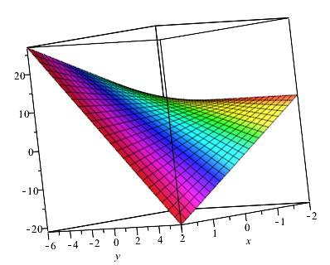
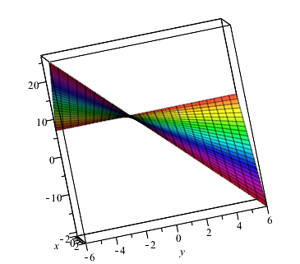
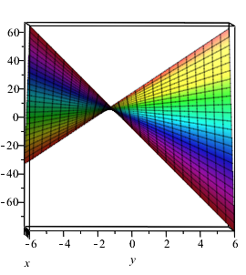
For the Projection
Projection:
We do not care some dimensions,
so the corresponding variables can be any values in its domain.
Sometimes, the variables can be eliminated from the equations,
then we exactly obtain the equations of its projection.
But sometimes we cannot.
Example:
projection on yOz
is any line through (y=-1, z=-3)
except the line y=-1

